Slide 1







Doctoral Days 2026
STIC
Hyper-representation for efficient Continual Learning
Tlili Aymen
Data Engineering and semantics – Faculty of sciences of Sfax
Supervisors:
Dr. Bassem Ben Hamed
ENET'Com
May 7, 2026

Slide 2






Outline
01
Context and motivation
01
02
Research Objectives
03
Proposed Approach
04
Experimental Results
05
Conclusion and Future Work
2

Slide 3
01
1
Context and motivation
3

Slide 4
Context and motivation
Hyper-representation give new intializations and are a compact way of saving models
Normal representations are Unstable to train and Doesn’t capture interpretable or semantic Knowledge
The rise of persistant Homology as an exploratory tool and later differiable for deep Learning
Create models effecients and avoid the training cost bottleneck in continual learning
Effeciently Merge Models and keep the best of each dataset
4

Slide 5
01
2
Research Objectives
5

Slide 6
Research Objectives
Showcase the value of Persistant homology
The addition to continual learning and it’s metrics
Bridge the finetuning gap of the predicted weights
Have more semanticly interpretable and condensed representations
Gain a better understanding of the weight space Manifold
6

Slide 7
01
3
Proposed Approach
7

Slide 8
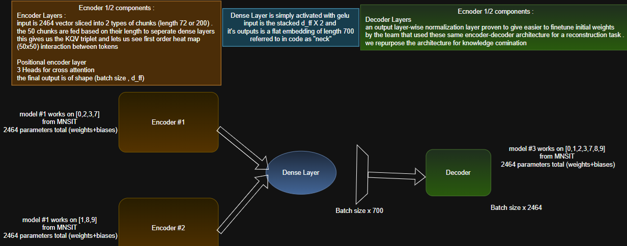
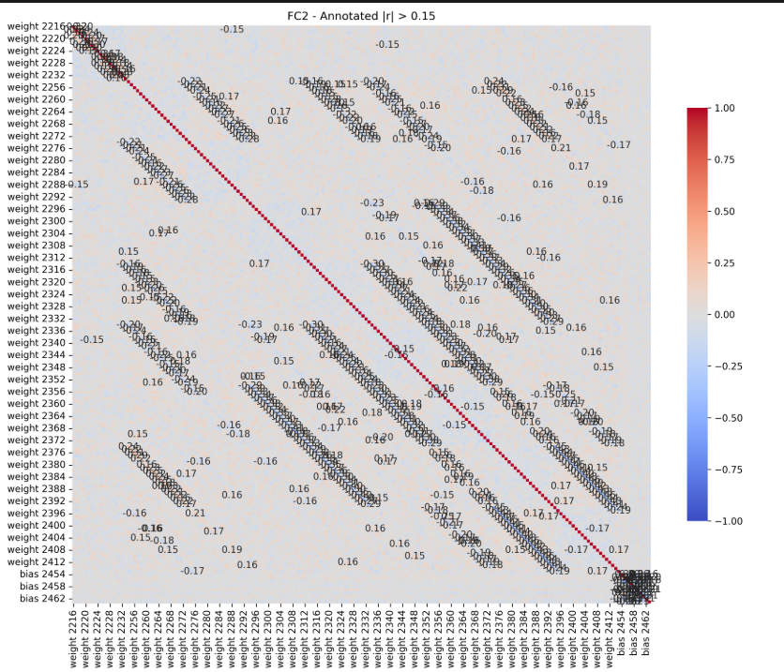
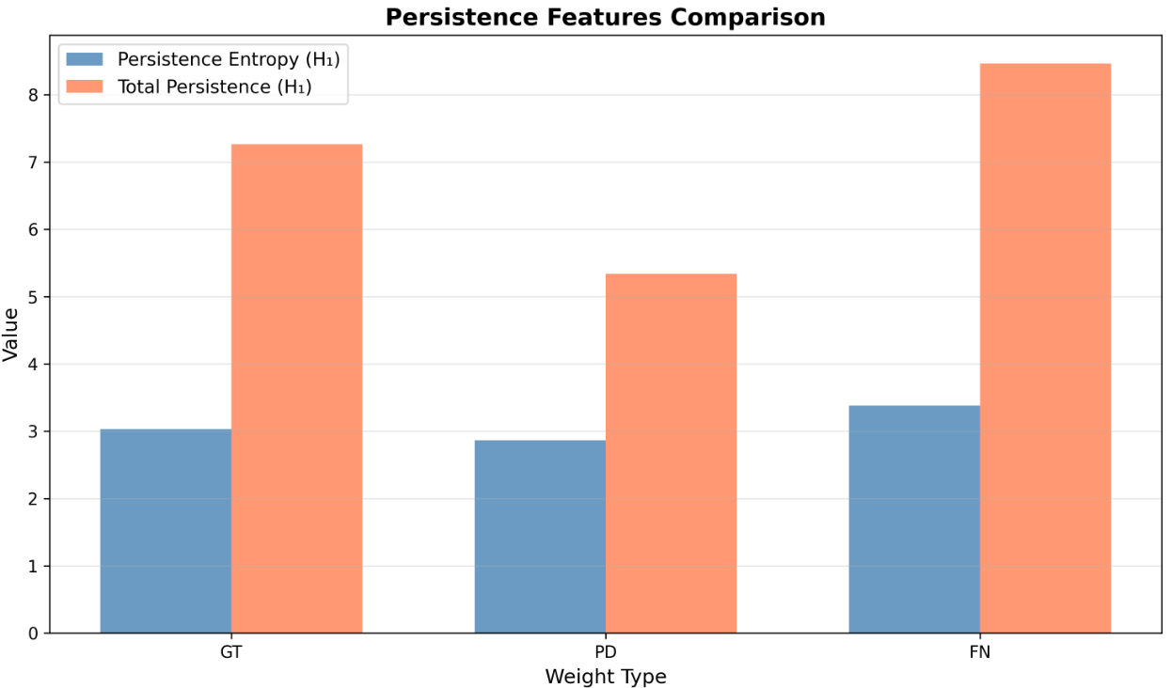
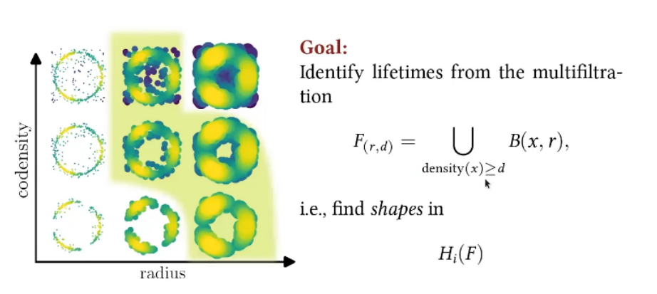
Proposed Approach
8

Slide 9
01
4
Experimental Results
9

Slide 10
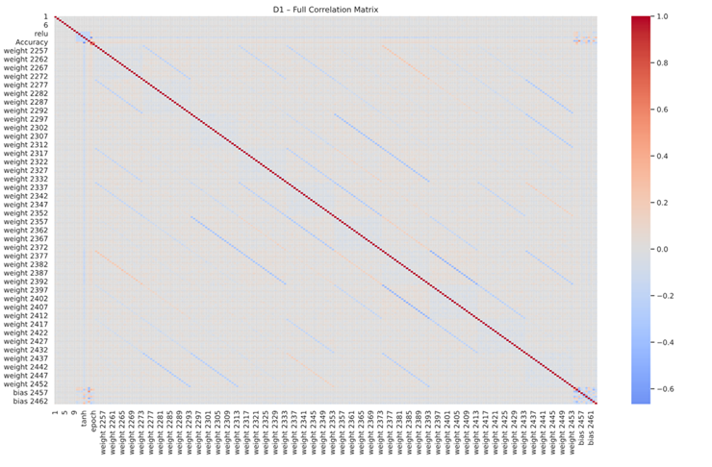
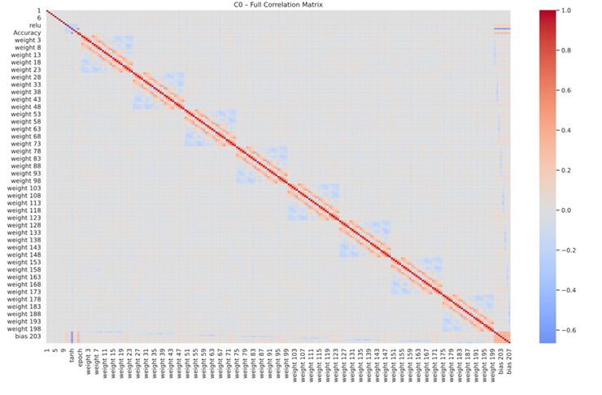
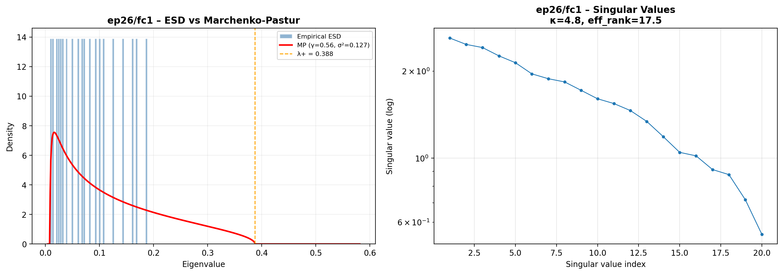
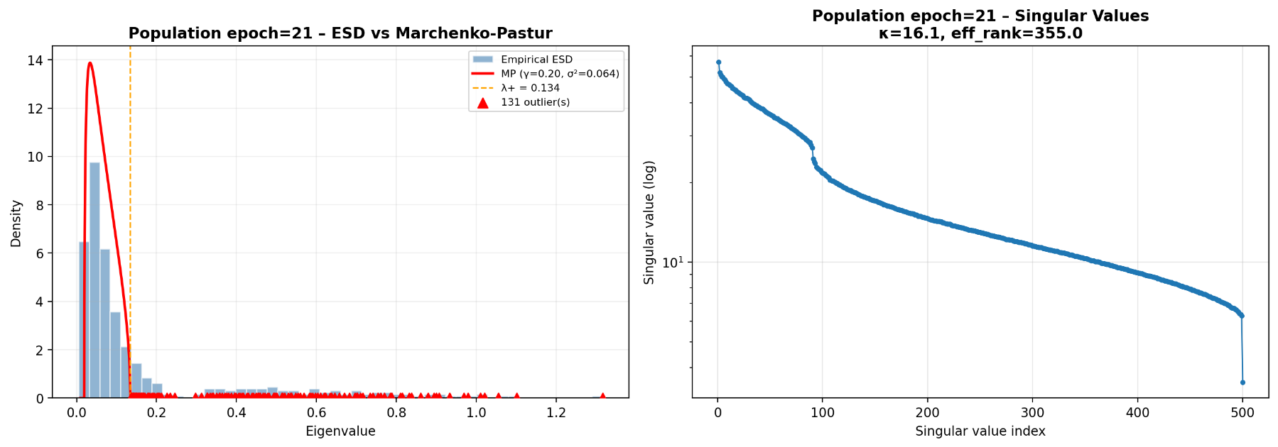
Experimental Results
10

Slide 11
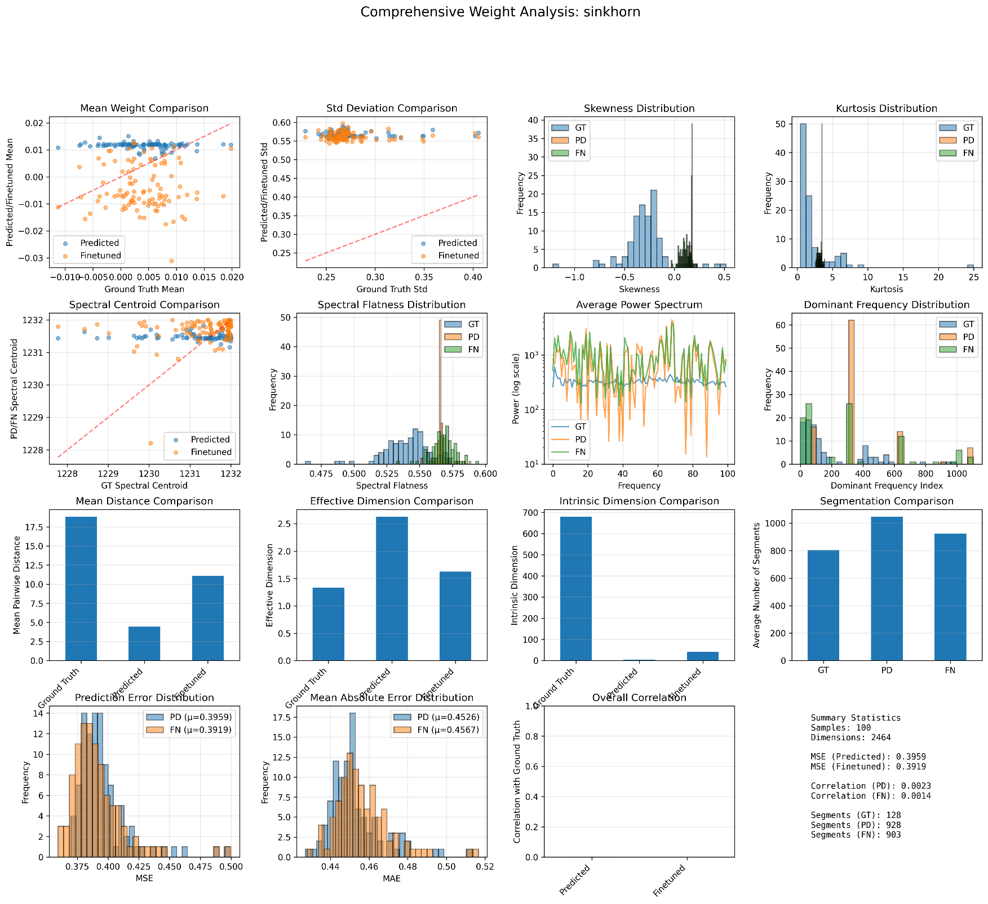
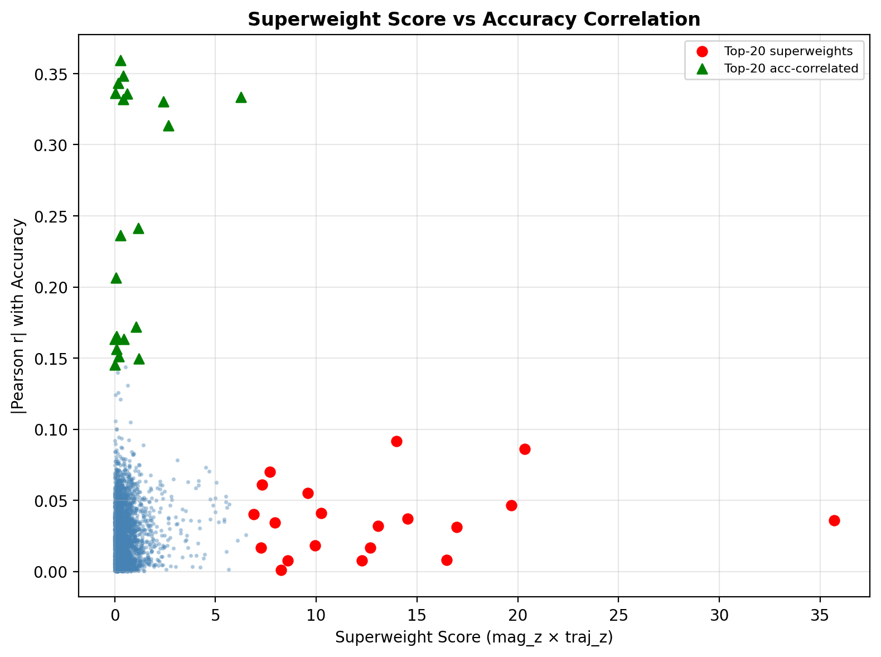
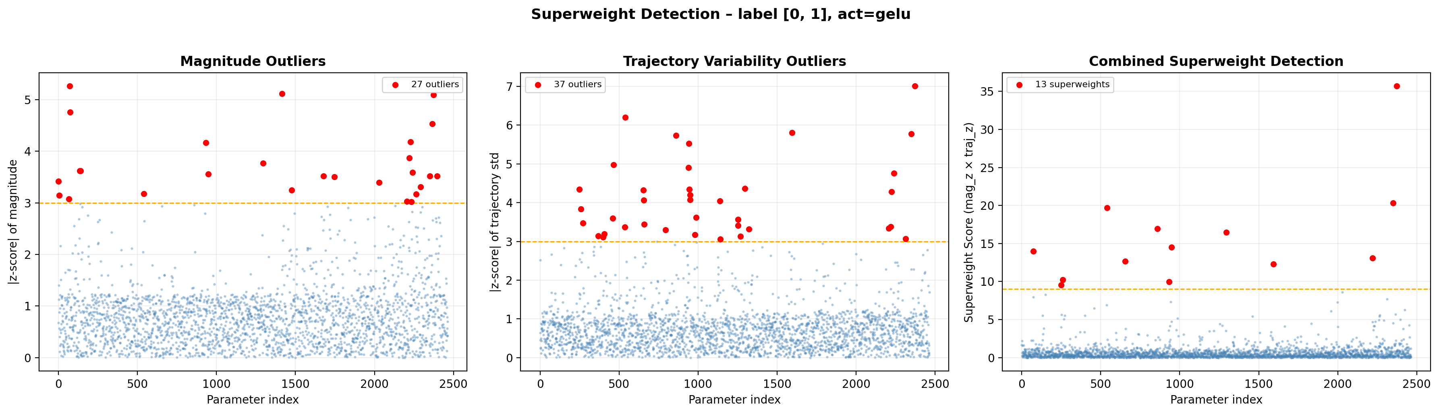

Slide 12
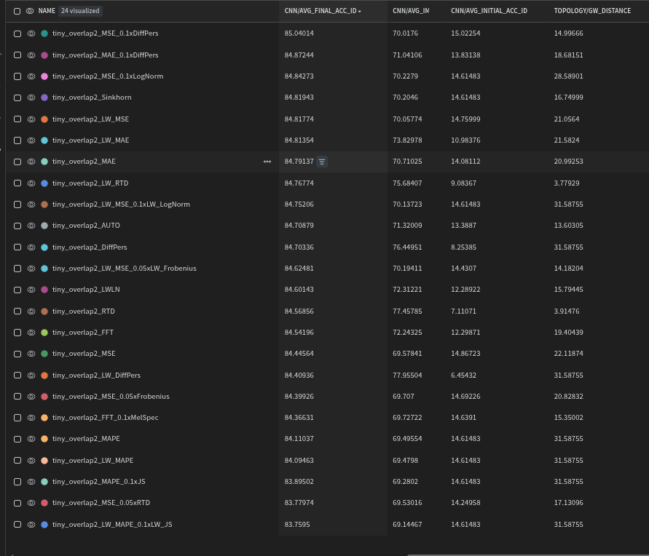
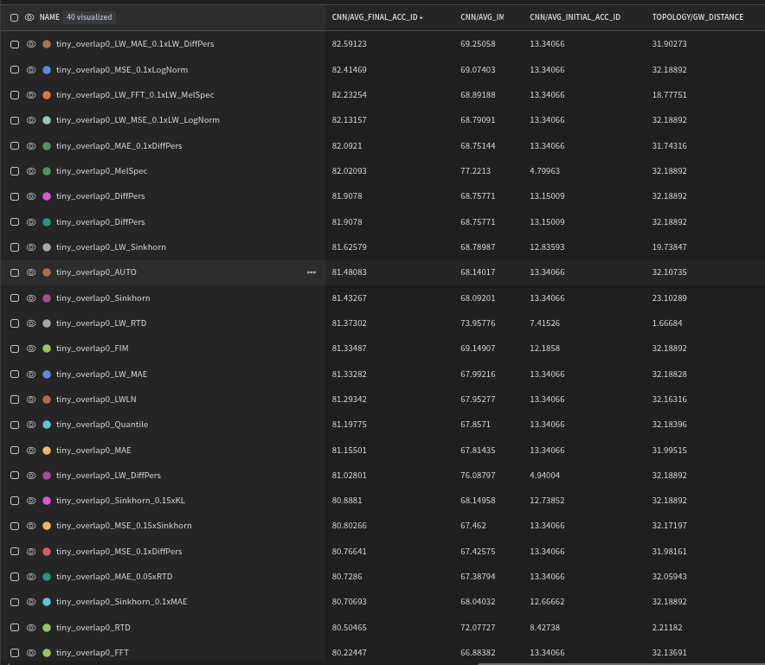
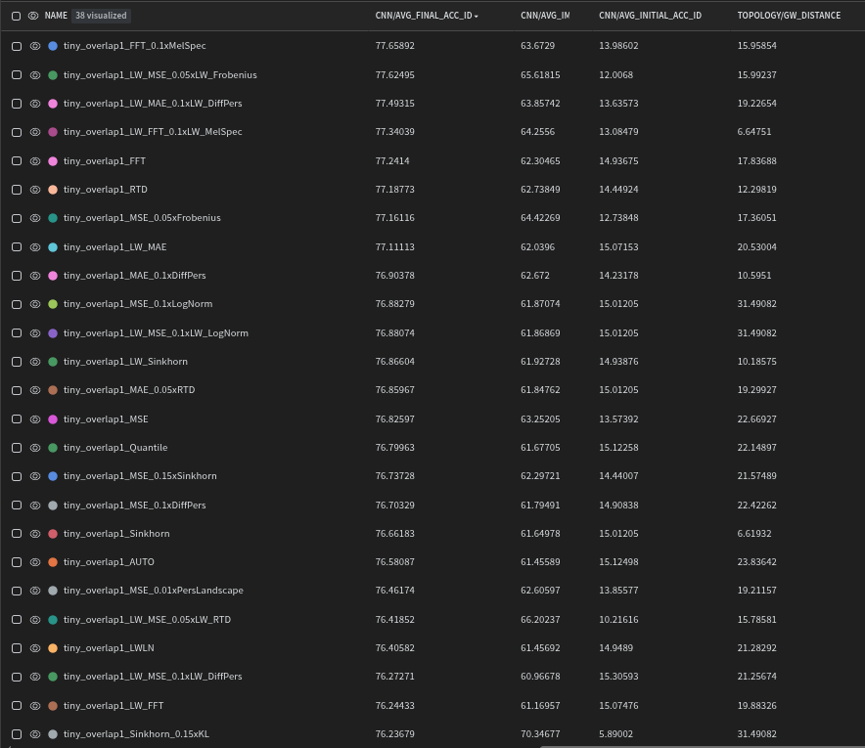
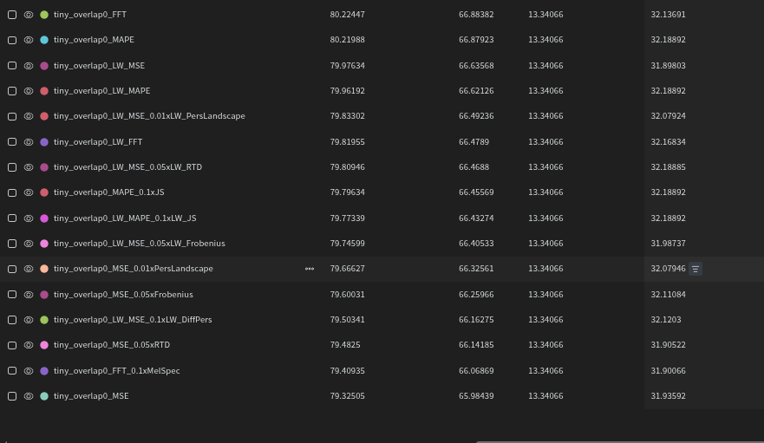
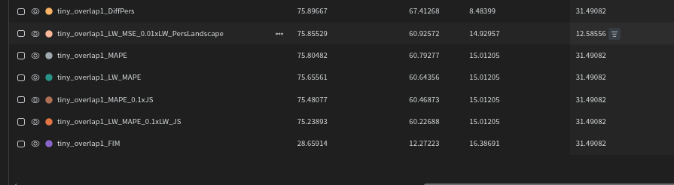

Slide 13
01
5
Conclusion and Future Work
11

Slide 14
Conclusion and Future Work
Weights that are highly Correlated are not necessarly the most critical for learning.
Having a higher rate of overlap makes the fusion process easier
Hyper-representations obey theoritical eigenvalue assymptotic rules even in
small number showcasing their compactiness
The Weights precited from different hyper-representations seem to collapse to the
Mode but in fact are very similar topologicaly depending on the loss function
Statistical structure is a byproduct of primordial topological and spectral structure
12

Slide 15











Future Work
Five phases showing feature development over time
01
02
03
04
05
step 1
step 2
step 3
step 4
step 5
Propose a feature that gives interprtation about neural network weights
prototype the feature on a random sample and real predicted sample
Discuss the comparison and implication on a larger scale as well as computation/feasability
Implement the feature in production at large scale and log it over time
Observe and discuss Patterns that appear on large bodies on neural network weights
13

Slide 16
01
Dataset Creation
04
FineTune the results
36 748 pairs of MNIST CNN weight pairs created
Train the predicted weights and observe stability
02
Custom Loss function implementation
05
Run analysis on the different sets
Adhere to Pytorch API and use LazyTensor
When needed/multipers
Ground Truth, Predicted weights, Finetuned Weight , Inputed weights
03
Train a metalearning Transformer
06
Compare Features
Effective choice of hyper-parameters to
Fit the computation time
Topological Spectral Statistical
14

Slide 17



Federated and Continual Learning
Impact on ML applications
Model interpretability and task disentanglement
Apply to Biomedical segmentation of CNNs for Brain tumors
Efficient Weight Fusion
Real World Pipelines
Integrate into the Mlops cycle of small Startups
Mathematical Foundations resurfacing through emprical results guiding future research directions
Answer Research Gaps about the utility of Hyper-representations
................................
Bring Community attention to the quality of the models and the proper tools to improve it
15

Slide 18
Thank you
for your attention!

